Slide 1
Modeling and Aggregation of Complex ANNOTATIONS
Alex Braylan
University of Texas at Austin

Slide 2
Outline
BACKGROUND
Annotation aggregation
  Probabilistic models of annotation
Motivation: complex annotations
  Problem statement
  Existing approaches
  Challenges
MY WORK
Contributions
  Annotation distances
  Probabilistic Model
  Simple Methods
Experiments
Results
Discussion

Slide 3
Background

Slide 4
ANNOTATION AGGREGATION
DATA SPECIFICATION
Workers (Users, Annotators)
Items
  Unobserved truth (gold value)
  Assumed to be objective not subjective
Annotations (Labels)
  At least one per item
  At most #workers per item
QUALITY CONTROL
Measuring consensus
  Majority vote
Measuring worker reliability
  “Honeypot” questions
Aggregation Models
  Dawid-Skene (1979): consensus and reliability
  ZenCrowd (Demartini et al 2012)
  GLAD: consensus, reliability, and difficulty
  (Whitehill et al 2009)

Slide 5

Aggregation Models
Probabilistic models
  Annotation data as noisy measurement
  Maximize probability of observed data, given unknowns
Goals include identification of:
  Gold labels
  Annotator reliability
  Item difficulty
Learn joint distribution of parameters
Observed: Label L, Worker u, Item i
Unobserved: Gold g, Latent parameters $θ$
P(L_{ui} | g_{i}, $θ$_{u}, $θ$_{i}, …)
5

Slide 6
From Simple to Complex Labels
SIMPLE LABELS EXAMPLES
Label sentiment of text
Classify object in image
Label spam email
Judge relevance of search results
Categorize medical conditions
MORE COMPLEX ANNOTATIONS?

Slide 7
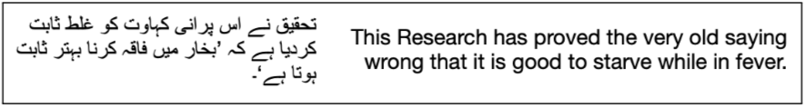
Examples of Free-Text Complex Annotations
FREE TEXT RESPONSE
Translation
Transcription
Summarization
Image captioning
Rationales
The grumpy cat is eating a donut
The animal is eating a sprinkle donut
Bartholomeow is about to eat a pink donut with sprinkles

Slide 8
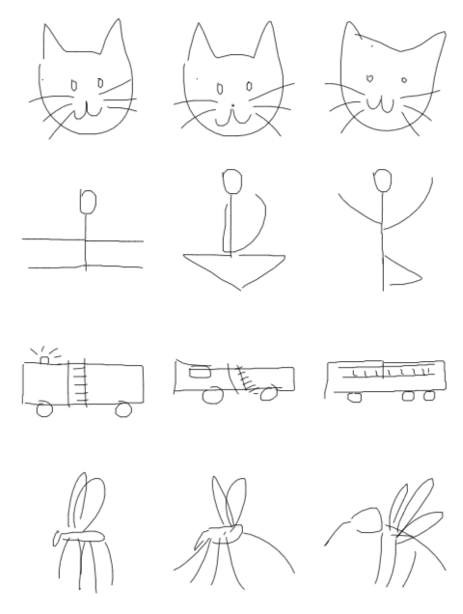
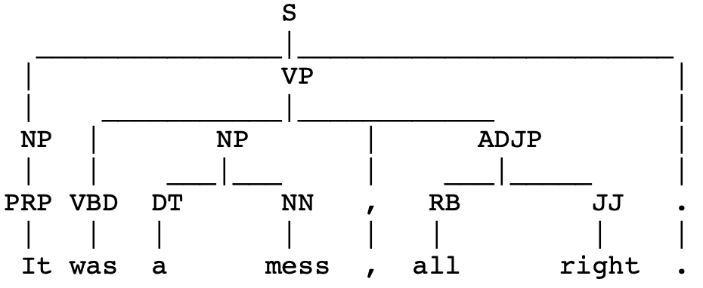
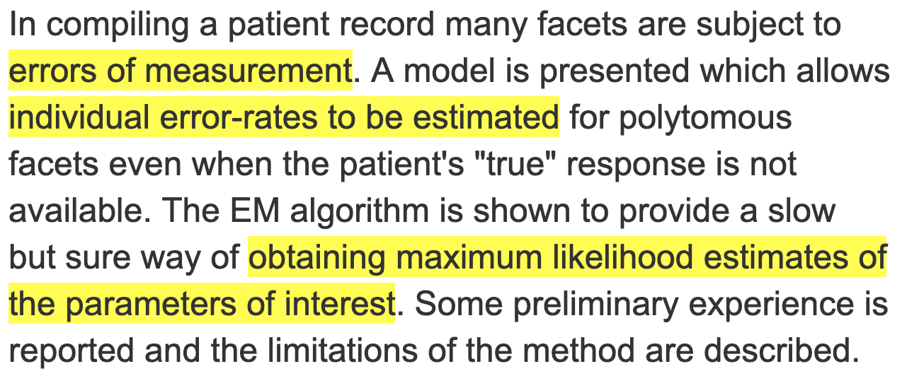
Examples of Non-Textual Complex Annotations
Drawings
Ranked lists
Parse Trees
Sequences

Slide 9
existing probabilistic models for complex annotations?
Arbitrarily complex data type
  Usually cannot be decomposed into simpler ones
Often involve very large or infinite space of possible values
  # of workers is usually << size of annotation space
  Therefore, less likely to get identical annotations
  Aggregation models for simple labels require exact consensus between labels
Bespoke, task-specific models such as:
  Sequence modeling (Nguyen et al 2017)
  Math problems (Lin, Mausam, and Weld 2012)

Slide 10
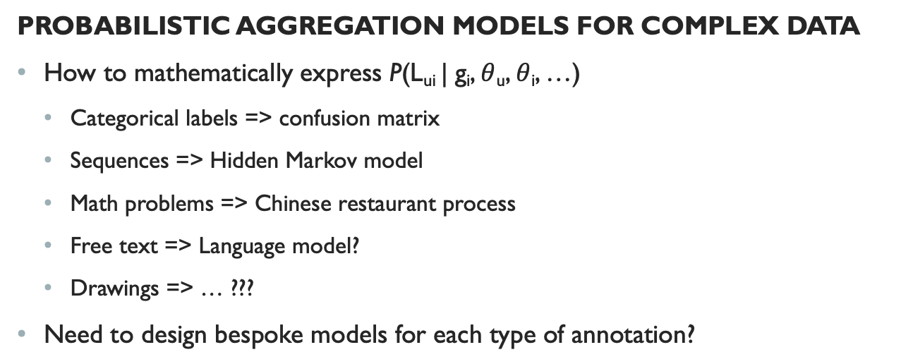
Challenges
PROBABILISTIC AGGREGATION MODELS FOR COMPLEX DATA
How to mathematically express P(L_{ui} | g_{i}, $θ$_{u}, $θ$_{i}, …)
  Categorical labels => confusion matrix
  Sequences => Hidden Markov model
  Math problems => Chinese restaurant process
  Free text => Language model?
  Drawings => … ???
Need to design bespoke models for each type of annotation?
Annotation space increasing in size
Generative distribution increasing in complexity

Slide 11
My Work So Far

Slide 12
Goals for Modeling Complex Annotations
We want aggregation models for complex data types
  Not just for crowd but anyone who might make mistakes – including experts
Probabilistic models of complex data types are difficult to formulate
  Prefer to work with models whose inputs, outputs, and parameters are basic data types like integers, floats, and vectors
Models should be applicable generally across many kinds of tasks
  Need method for converting problem to common state space

Slide 13
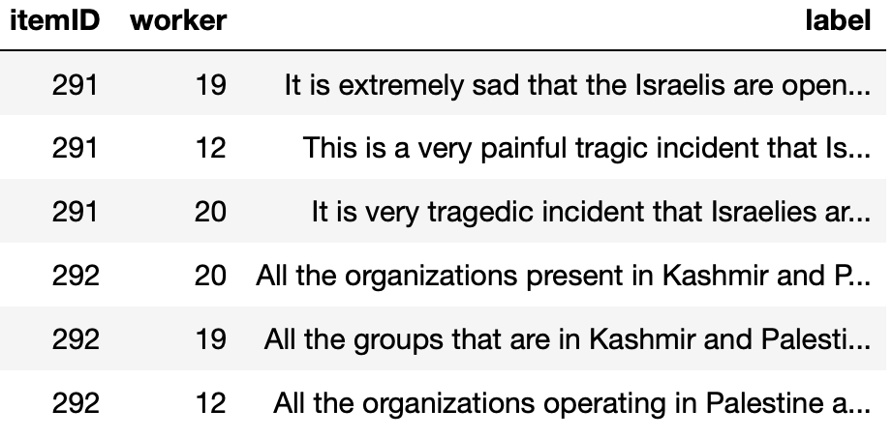
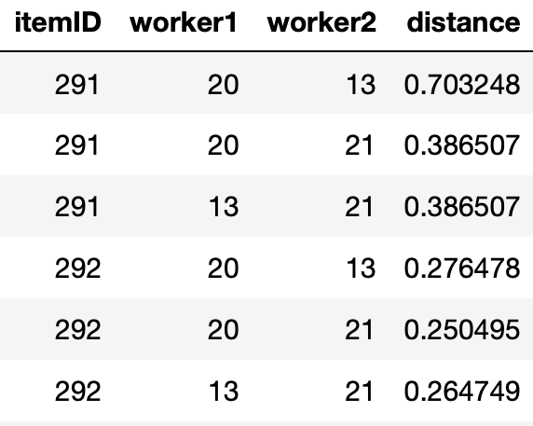
From Annotations to Annotation Distances
Use distance function to convert data
20
13
21
21
20
13

Slide 14
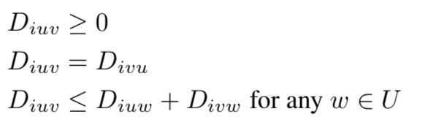
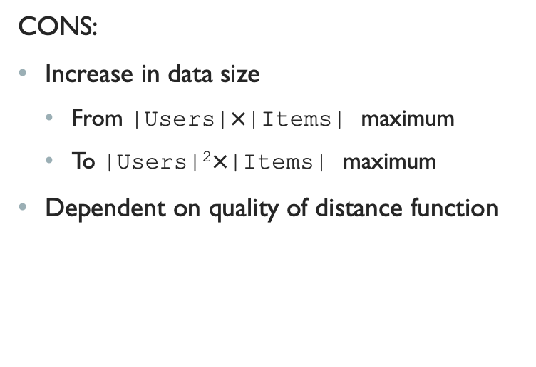
Conversion to
Annotation Distances
PROS:
Distance function much easier to produce than probabilistic model
  Most data types already have at least one well-known distance function
  Evaluation metric itself can be used as distance function
Resulting data is not task-specific
  Model for distances need not know anything about the original data type
CONS:
Increase in data size
  From |Users|$×$|Items| maximum
  To |Users|²$×$|Items| maximum
Dependent on quality of distance function
properties of distance function

Slide 15
How to Use Distance Matrices for annotation Modeling
Need a principled framework for modeling annotation distances
  Goal is to do the things we do with annotation models (e.g. Dawid-Skene),
  but with annotation distance data
Natural starting point is Multidimensional Scaling (Kruskal & Wish 1978)
  Model for distance matrix data

Slide 16
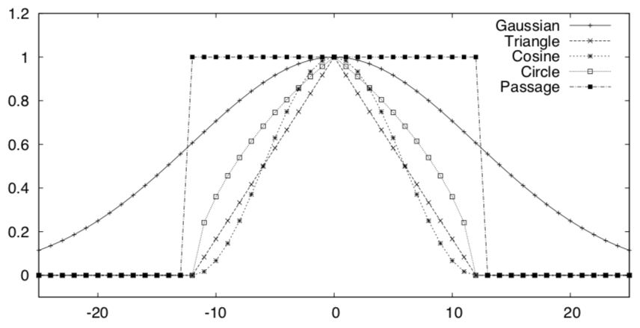
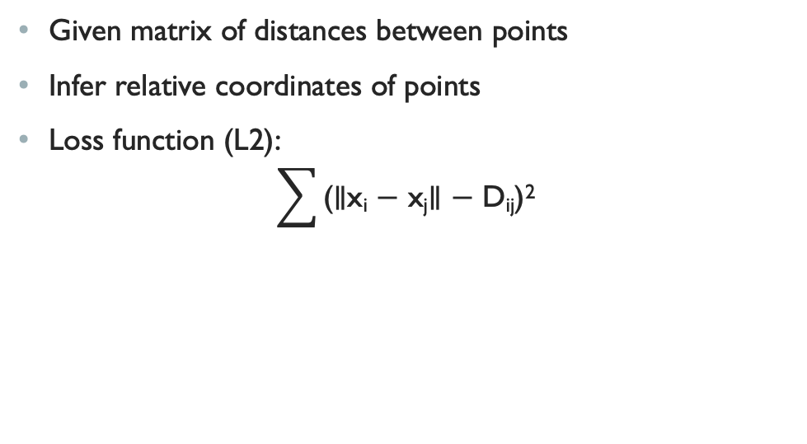
Multidimensional Scaling
Given matrix of distances between points
Infer relative coordinates of points
Loss function (L2):
$\sum{\text{(∥}\text{xi}\text{ − }\text{xj}\text{∥ − }\text{Dij}\text{)}\text{2}}$
Future work:
other distance functions
(Lv and Zhai 2009) (kernel functions)

Slide 17
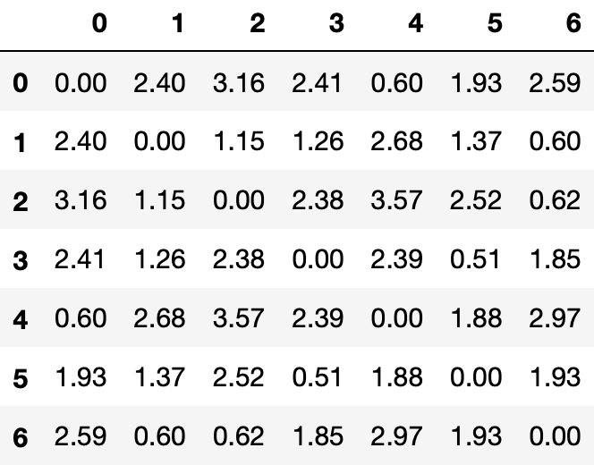
Multidimensional Scaling example
True Coordinates (unobserved)
Distance Matrix
(observed)
Inferred Coordinates

Slide 18
Multidimensional annotation scaling (MAS)
Probabilistic model of multi-item distance matrices
“Hierarchical Bayesian” multidimensional scaling
  Additional learned parameters representing crowd effects such as annotator reliability
Intended as complex-label analogue of Dawid-Skene
Equal reliability
(majority vote)
Varying reliability

Slide 19

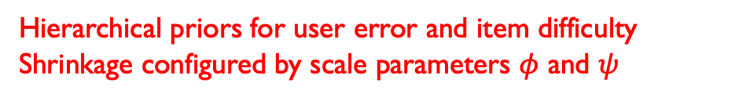

MAS Formulation
Multidimensional scaling objective
D_{iuv} ∼ N(∥ε_{iu}−ε_{iv}∥, σ)
ε_{iu} = $γ$_{u}$δ$_{i} $\frac{\tilde{ε}\text{iu}}{\text{|}\tilde{ε}\text{iu}\text{|}}$ )
$\tilde{ε}$_{iu} ∼ N(0, $1$)
$log⁡(γ$_{u}) ~ N($log(\overline{γ}), φ)$
$log⁡(δ$_{u}) ~ N(log($\overline{δ}), ψ)$
$γ$ for user error, $δ$ for item difficulty
Hierarchical priors for user error and item difficulty
Shrinkage configured by scale parameters $φ$ and $ψ$

Slide 20
MAS Intuition
Modeled coordinate space
Multidimensional scaling objective puts similar annotations near each other
Prior on coordinates penalizes them for straying too far from origin
With constant prior:
  Emulates majority vote
With prior varying by user error:
  Emulates weighting by user ability
Implied gold

Slide 21
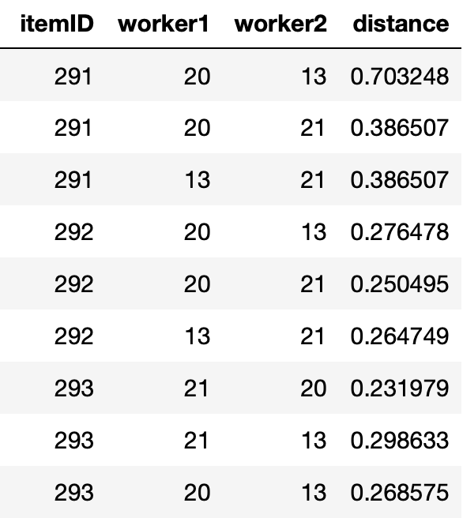
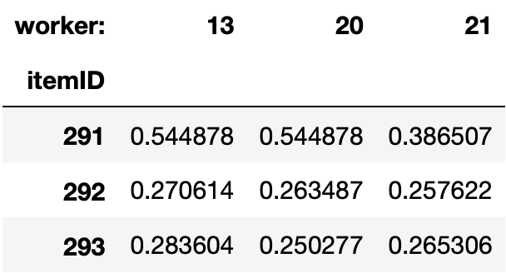
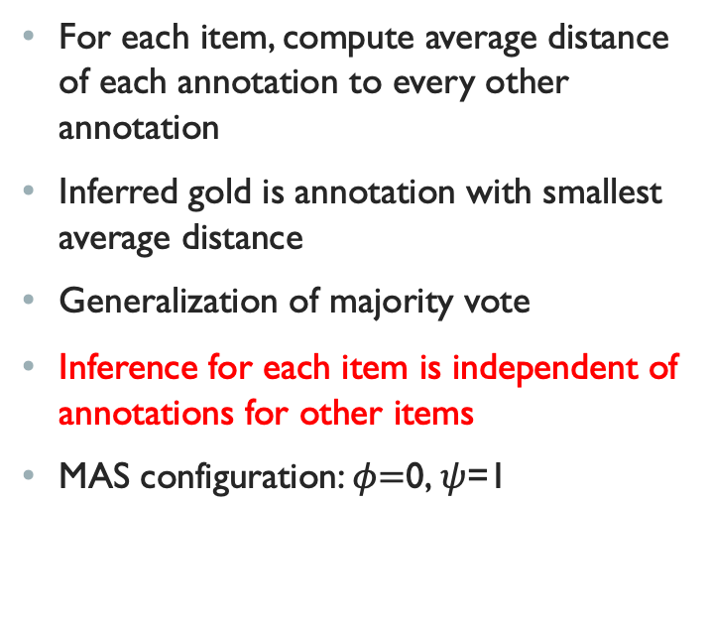
Simpler Variant 1:
Smallest Average Distance (SAD)
For each item, compute average distance of each annotation to every other annotation
Inferred gold is annotation with smallest average distance
Generalization of majority vote
Inference for each item is independent of annotations for other items
MAS configuration: $φ\text{=}\text{0,} ψ$=1

Slide 22
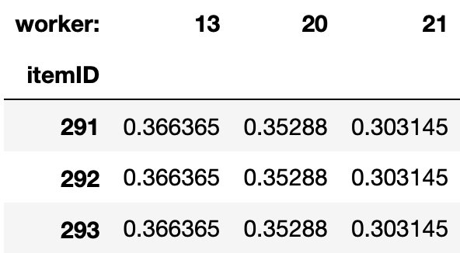
Simpler Variant 2:
Best AvAIlable User (BAU)
For each worker (user), compute average distance over whole dataset
Inferred gold is annotation made by worker with smallest average distance
Estimates worker reliability as overall peer-agreement
Worker error treated as constant, item-level variation washed out

Slide 23
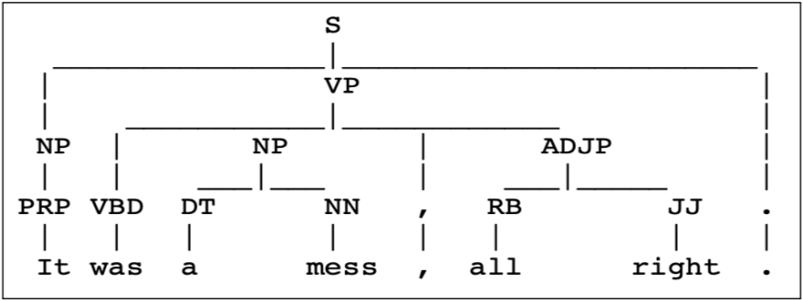
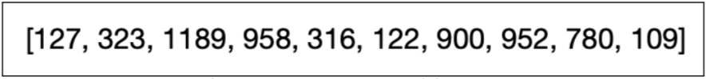
Experiments:
Evaluation Data
SYNTHETIC DATASETS
Syntactic parse trees
  Distance function: evalb
Ranked lists
  Distance function: Kendall’s tau
REAL DATASETS
Biomedical text sequences
  Distance function: Span-wise F1
Urdu-English translations
  Distance function: GLEU

Slide 24
Methods Compared
Baselines:
  Random User (RU)
  Oracle (OR)
Ours:
  Best Available User (BAU)
  Smallest Annotation Distance (SAD)
  Multidimensional Annotation Scaling (MAS)
Sequences only (Nguyen et al 2017):
  Token-wise Majority Vote (MV)
  Hidden Markov Model Crowd (HMM)

Slide 25
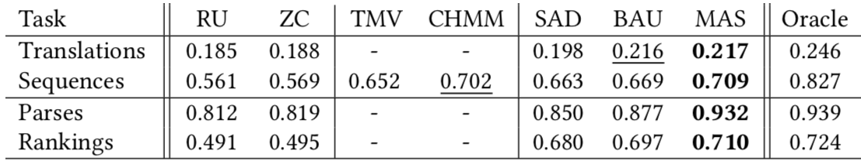
Results
Sequences:
  Distance-based methods beat MV
  MAS competitive with bespoke model
Translations
  MAS and BAU win
Parsers and Rankings
  MAS wins

Slide 26
Conclusion
Goal: general-purpose probabilistic model to aggregate complex annotations
  Categorical-based methods insufficient
  Bespoke models difficult to design for new annotation types
Solution: Model annotation distances via task-specific distance functions
  Transforms problem into general-purpose variable space
Multi-dimensional Annotation Scaling allows Dawid-Skene-like aggregation
  Weighted voting with inferred annotator reliability

Slide 27
Future and Ongoing Work
Big picture: what is everything needed to support complex crowd-sourcing?
  Integration with other quality-control mechanisms
  Semi-supervised learning
  Dynamic (online) collection – how to measure value of uncertainty reduction
  Complex merge functions (not just winner take all)
  Learning difficult tasks over time
  Extend proposed model from distances to similarities
  Partial-credit scoring of annotations

