Slide 1
Modeling and Aggregation of Complex ANNOTATIONS
Alex Braylan
University of Texas at Austin

Slide 2
ANNOTATION Modeling
DATA SPECIFICATION
Workers (Users, Annotators)
Items
  Unobserved truth (gold value)
  Assumed to be objective not subjective
Annotations (Labels)
  At least one per item
  At most #workers per item
QUALITY CONTROL
Measuring consensus
  Majority vote
Measuring worker reliability
  “Honeypot” questions
Aggregation Models
  Dawid-Skene (1979): consensus and reliability
  ZenCrowd (Demartini et al 2012)
  GLAD: consensus, reliability, and difficulty
  (Whitehill et al 2009)

Slide 3

Aggregation Models
Goals include identification of:
  Gold labels
  Annotator reliability
  Item difficulty
Probabilistic models
  Annotation data as noisy measurement
  Learn joint distribution of parameters
Observed: Label L, Worker u, Item i
Unobserved: Gold g, Latent parameters $θ$
P(g_{i}, $θ$_{u}, $θ$_{i}, … | L_{ui})
3

Slide 4
From Simple to Complex Labels
SIMPLE LABELS EXAMPLES
Label sentiment of text
Classify object in image
Label spam email
Judge relevance of search results
Categorize medical conditions
MORE COMPLEX ANNOTATIONS?

Slide 5
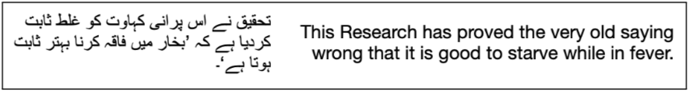
Examples of Free-Text Complex Annotations
FREE TEXT RESPONSE
Translation
Transcription
Summarization
Image captioning
Rationales
The grumpy cat is eating a donut
The animal is eating a sprinkle donut
Bartholomeow is about to eat a pink donut with sprinkles

Slide 6
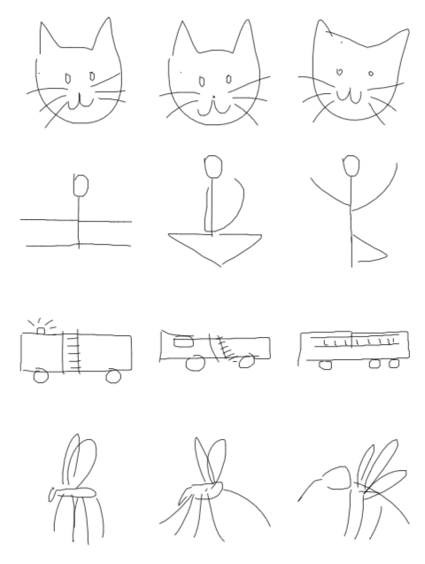
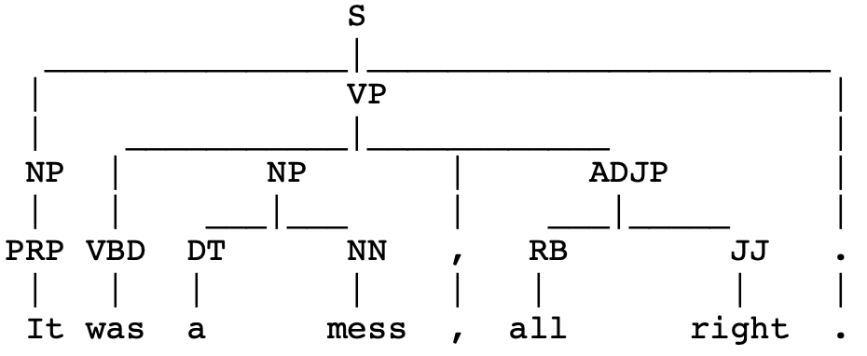
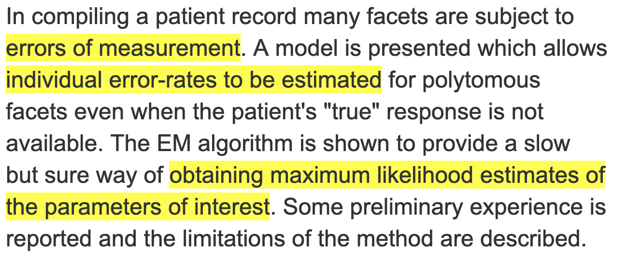
Examples of Non-Textual Complex Annotations
Drawings
Ranked lists
Parse Trees
Sequences

Slide 7
existing probabilistic models for complex annotations?
Arbitrarily complex data type
  Usually cannot be decomposed into simpler ones
Often involve very large or infinite space of possible values
  # of workers is usually << size of annotation space
  Therefore, less likely to get identical annotations
  Aggregation models for simple labels require exact consensus between labels
Bespoke, task-specific models such as:
  Sequence modeling (Nguyen et al 2017)
  Math problems (Lin, Mausam, and Weld 2012)

Slide 8
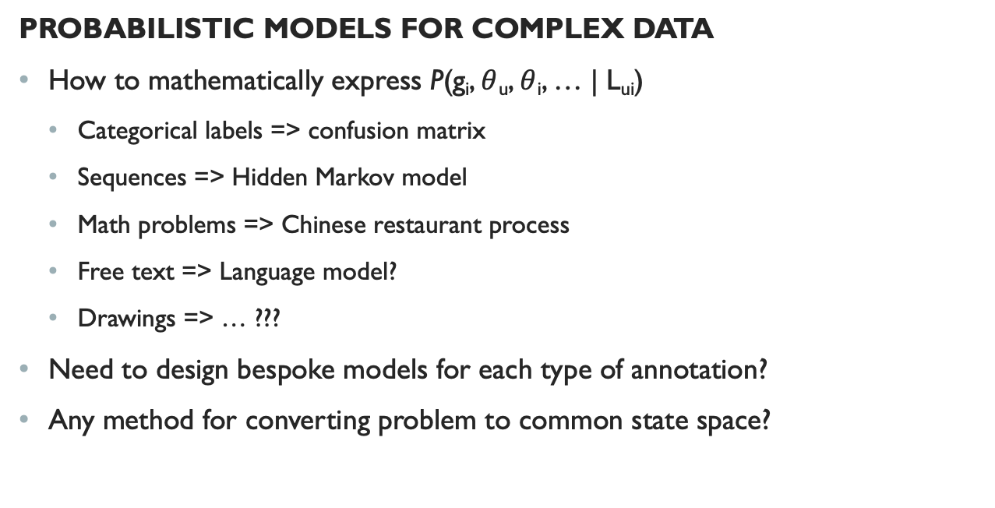
Challenges
PROBABILISTIC MODELS FOR COMPLEX DATA
How to mathematically express P(g_{i}, $θ$_{u}, $θ$_{i}, … | L_{ui})
  Categorical labels => confusion matrix
  Sequences => Hidden Markov model
  Math problems => Chinese restaurant process
  Free text => Language model?
  Drawings => … ???
Need to design bespoke models for each type of annotation?
Any method for converting problem to common state space?
Annotation space increasing in size
Generative distribution increasing in complexity

Slide 9
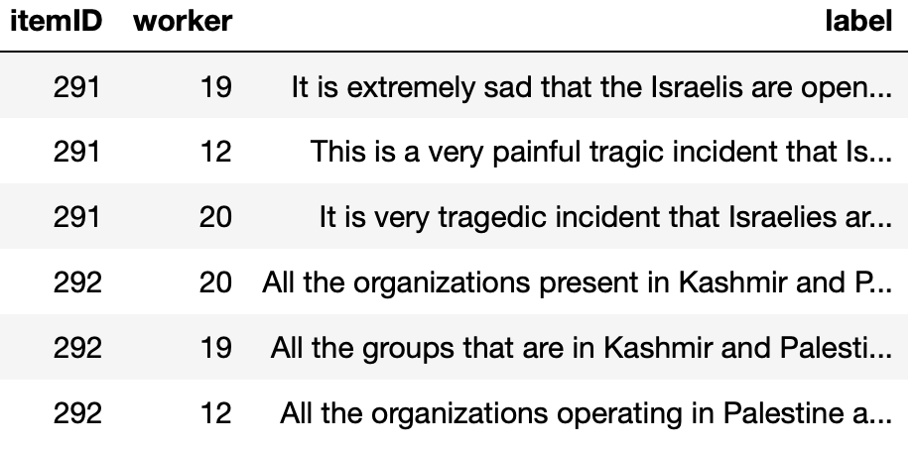
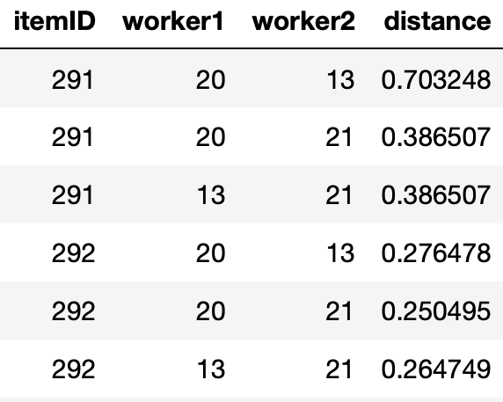
From Annotations to Annotation Distances
Use distance function to convert data
20
13
21
21
20
13

Slide 10
How to Use Distance Matrices for annotation Modeling
Need a principled framework for modeling annotation distances
  Goal is to do the things we do with annotation models (e.g. Dawid-Skene),
  but with annotation distance data
Natural starting point is Multidimensional Scaling (Kruskal & Wish 1978)
  Model for distance matrix data

Slide 11
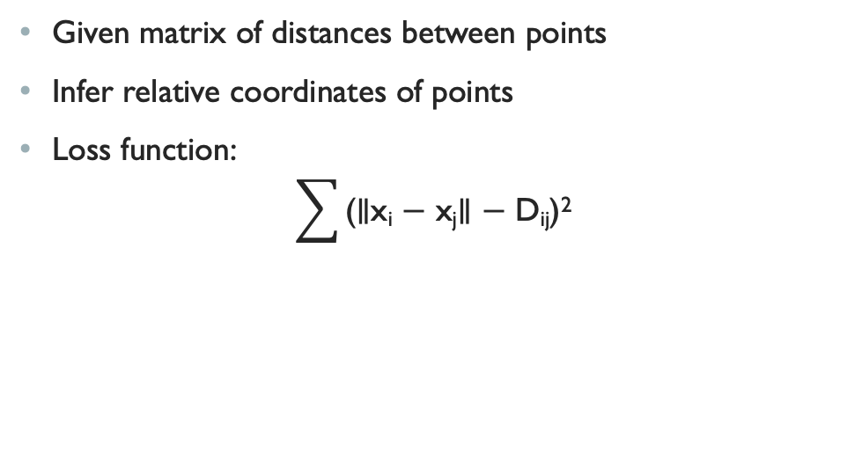
Multidimensional Scaling
Given matrix of distances between points
Infer relative coordinates of points
Loss function:
$\sum{\text{(∥}\text{xi}\text{ − }\text{xj}\text{∥ − }\text{Dij}\text{)}\text{2}}$

Slide 12
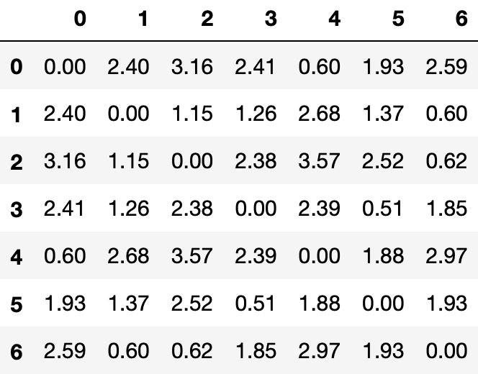
Multidimensional Scaling example
True Coordinates (unobserved)
Distance Matrix
(observed)
Inferred Coordinates

Slide 13
Multidimensional annotation scaling (MAS)
Probabilistic model of multi-item distance matrices
“Hierarchical Bayesian” multidimensional scaling
  Additional learned parameters representing crowd effects such as annotator reliability
Intended as complex-label analogue of Dawid-Skene
Equal reliability
(majority vote)
Varying reliability

Slide 14

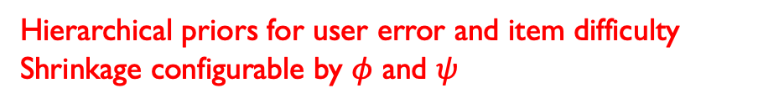

MAS Formulation
D_{iuv} ∼ N(∥ε_{iu}−ε_{iv}∥, σ)
ε_{iu} = $γ$_{u}$δ$_{i} $\frac{\tilde{ε}\text{iu}}{\text{|}\tilde{ε}\text{iu}\text{|}}$ )
$\tilde{ε}$_{iu} ∼ N(0, $1$)
$log⁡(γ$_{u}) ~ N($log(\overline{γ}), φ)$
$log⁡(δ$_{u}) ~ N(log($\overline{δ}), ψ)$
Multidimensional scaling objective
$γ$ for user error, $δ$ for item difficulty
Hierarchical priors for user error and item difficulty
Shrinkage configurable by $φ$ and $ψ$

Slide 15
MAS Intuition
Modeled coordinate space
Multidimensional scaling likelihood puts similar annotations near each other
Prior on coordinates penalizes them for straying too far from origin
With constant prior:
  Emulates majority vote
With prior varying by user error:
  Emulates weighting by user ability
Implied gold

Slide 16


Simpler Options
SMALLEST AVERAGE DISTANCE (SAD)
For each item, calculate average distance from each annotation to all others
BEST AVAILABLE USER (BAU)
For each user, calculate average annotation distance across all items
*generalizes majority vote

Slide 17
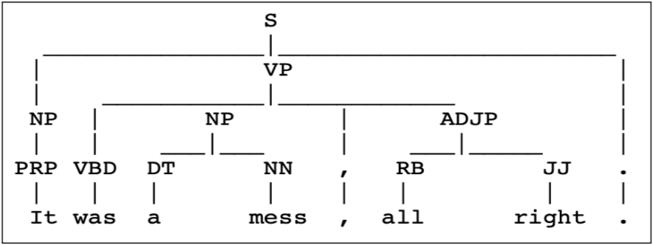
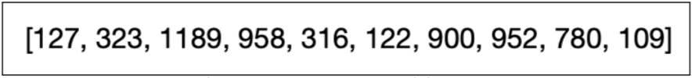
Experiments:
Evaluation Data
SYNTHETIC DATASETS
Syntactic parse trees
  Distance function: evalb
Ranked lists
  Distance function: Kendall’s tau
REAL DATASETS
Biomedical text sequences
  Distance function: Span-wise F1
Urdu-English translations
  Distance function: BLEU

Slide 18
Methods Compared
Baselines:
  Random User (RU)
  Oracle (OR)
Ours:
  Best Available User (BAU)
  Smallest Annotation Distance (SAD)
  Multidimensional Annotation Scaling (MAS)
Sequences only (Nguyen et al 2017):
  Token-wise Majority Vote (MV)
  Hidden Markov Model Crowd (HMM)

Slide 19
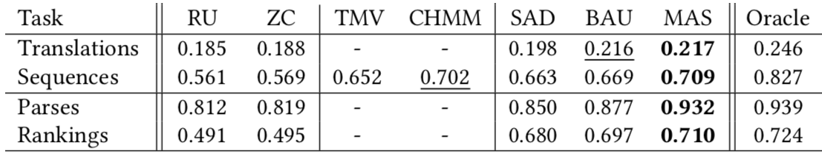
Results
Sequences:
  Distance-based methods beat MV
  MAS competitive with bespoke model
Translations
  MAS and BAU win
Parsers and Rankings
  MAS wins

Slide 20
Conclusion
Goal: general-purpose probabilistic model to aggregate complex annotations
  Categorical-based methods insufficient
  Bespoke models difficult to design for new annotation types
Solution: Model annotation distances via task-specific distance functions
  Transforms problem into general-purpose variable space
Multi-dimensional Annotation Scaling allows Dawid-Skene-like aggregation
  Weighted voting with inferred annotator reliability

Slide 21
Future and Ongoing Work
Big picture: what is everything needed to support complex crowd-sourcing?
  Semi-supervised learning
  Partial-credit scoring of annotations
  Dynamic (online) collection – how to measure value of uncertainty reduction
  Complex merge functions (not just winner take all)
  Learning difficult tasks over time

Slide 22
Thank You!
braylan@cs.utexas.edu

Slide 23
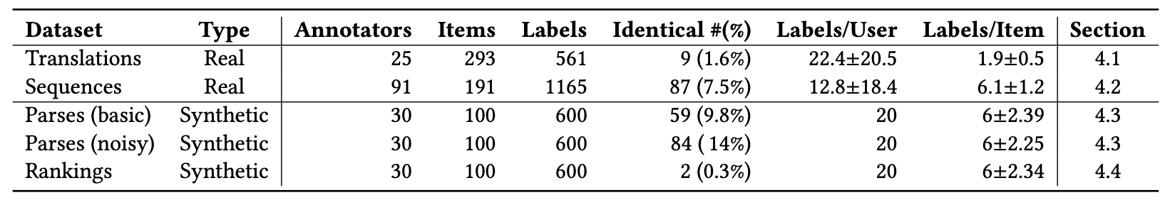
Appendix: Datasets

